Slide 1

Yelp Business Performance Analysis
ALY6110 – Data Management and Big Data
CRN: 80437
Group Delta
Likhitha Varakala (varakala.l@northeastern.edu)
Manmitha Pantangi (pantangi.m@northeastern.edu)
Ayushi Walia (walia.ay@northeastern.edu)
Aditi Rajmane (rajmane.a@northeastern.edu)
Zhiyuan Xue (xue.zhiyu@notheastern.edu)

Slide 2
Contents
01
02
03
04
Introduction
Analysis
Visualizations
Conclusion

Slide 3
Introduction
The problem being addressed in the analysis of the Yelp dataset is to understand the factors that contribute to the success of businesses on Yelp. By exploring the dataset and performing various analyses, the goal is to uncover insights that can guide business owners in enhancing their performance, improving customer satisfaction, and ultimately achieving success on the Yelp platform.
Benefits:
1.Business Performance Improvement
2.Customer Satisfaction Enhancement
3.Competitive Advantage
Drawbacks:
1.Data Limitations
2.Causality vs. Correlation
3.External Factors

Slide 4
Dataset
The dataset that we chose for the project is the Yelp dataset obtained from Kaggle. The dataset contains approximately one million rows and 14 attributes.
ID: The unique identifier for each entry in the dataset.
Time_GMT: The time of the entry in GMT (Greenwich Mean Time).
Phone: The phone number associated with the business.
Organization: The name or organization associated with the business.
OLF: Unknown variable
Rating: The average rating given to the business.
NumberReview: The total number of reviews for the business.
Category: The category or type of business (e.g., restaurant).
Country: The country where the business is located.
CountryCode: The country code of the business location.
State: The state or province where the business is located.
City: The city where the business is located.
Street: The street address of the business.
Building: The building number or identifier associated with the business.

Slide 5
Challenges
01
02
03
04
Big Data Processing
Data Preprocessing
Complex Relationships
Interpreting Results

Slide 6
Challenges
01
02
03
04
Big Data Processing
Data Preprocessing
Complex Relationships
Interpreting Results

Slide 7
Tools and Techniques used:
In the project, several tools and techniques were used to analyze the Yelp dataset.
PySpark
Spark SQL
Dataframe API
Data Processing Techniques
Exploratory Data Analysis
Aggregation and Statistical Functions
Clustering algorithm

Slide 8
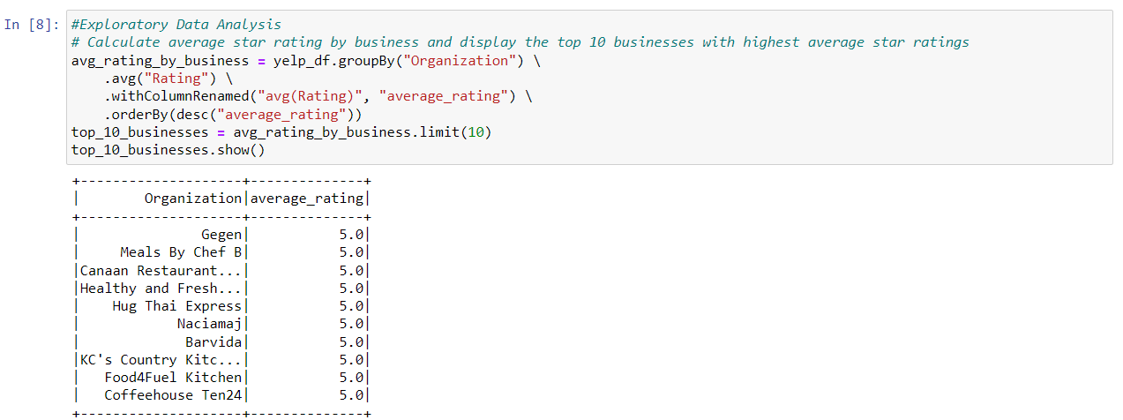
Average Rating by Organization

Slide 9
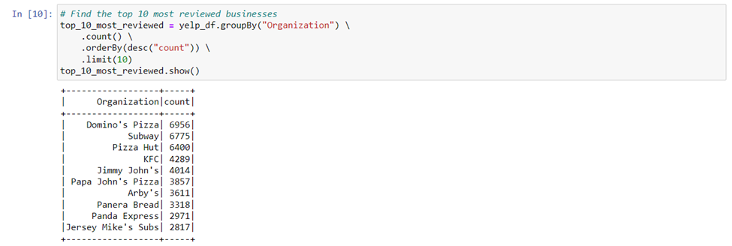
Top 10 most reviewed businesses

Slide 10
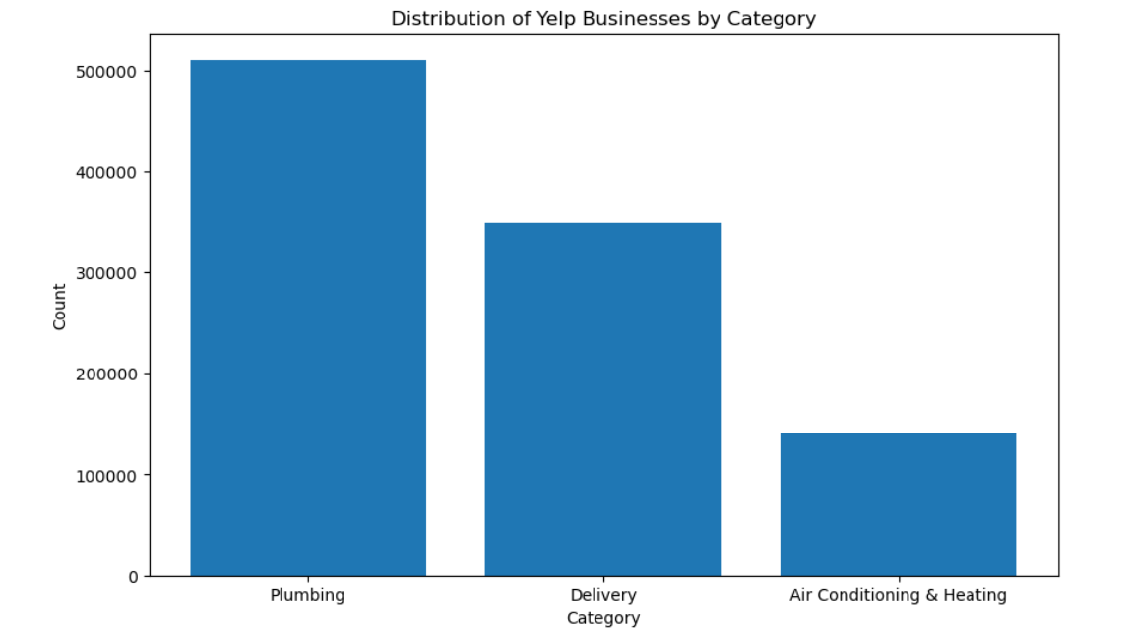
Distribution of Yelp Businesses by Category

Slide 11
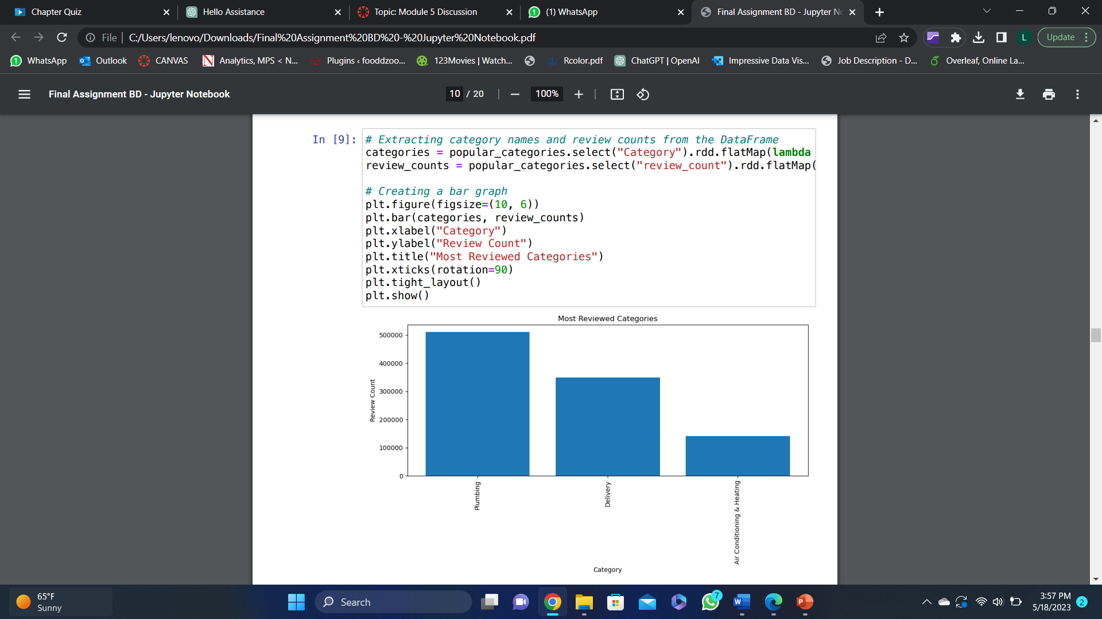
Most reviewed categories

Slide 12
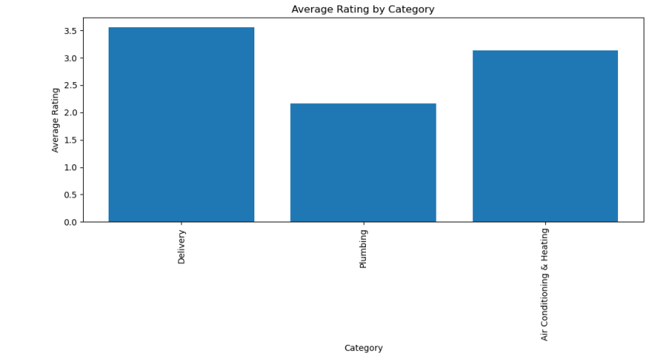
Average Rating by Category

Slide 13
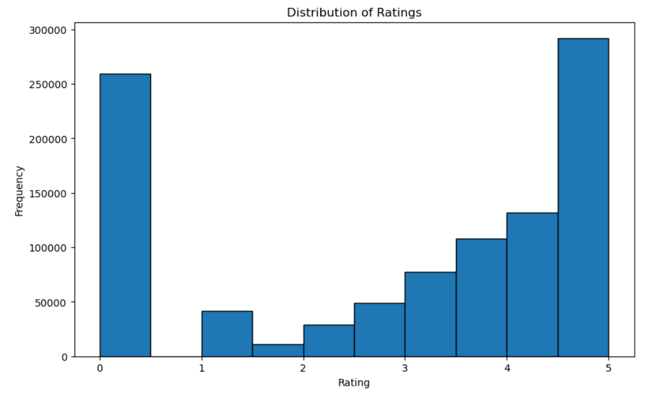
Distribution of Ratings

Slide 14
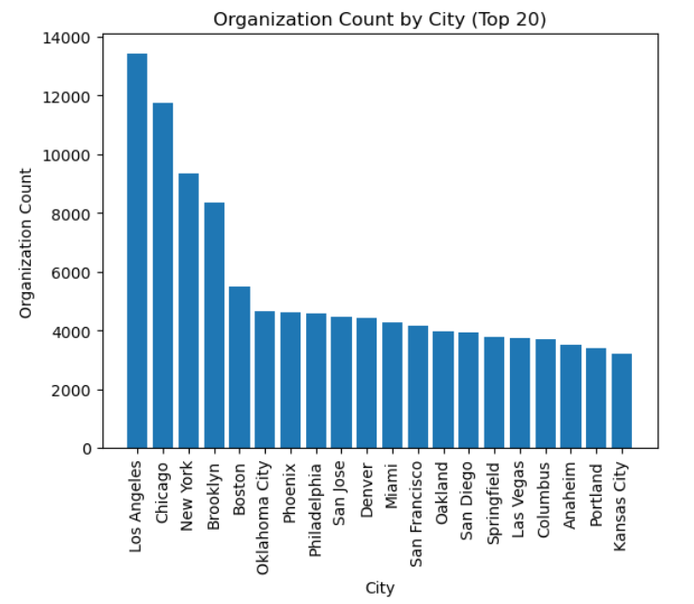
Top 20 organizations count by city

Slide 15
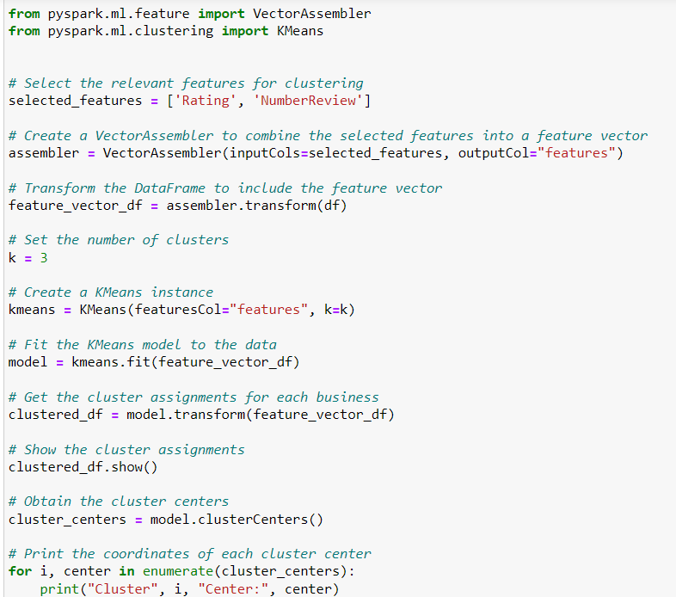
Clustering Analysis
The code includes the following imports:
VectorAssembler is utilized to combine selected features into a single feature vector column.
KMeans is the clustering algorithm employed for executing K-means clustering.
SparkSession is used to create a SparkSession, which serves as the starting point for working with Spark.

Slide 16
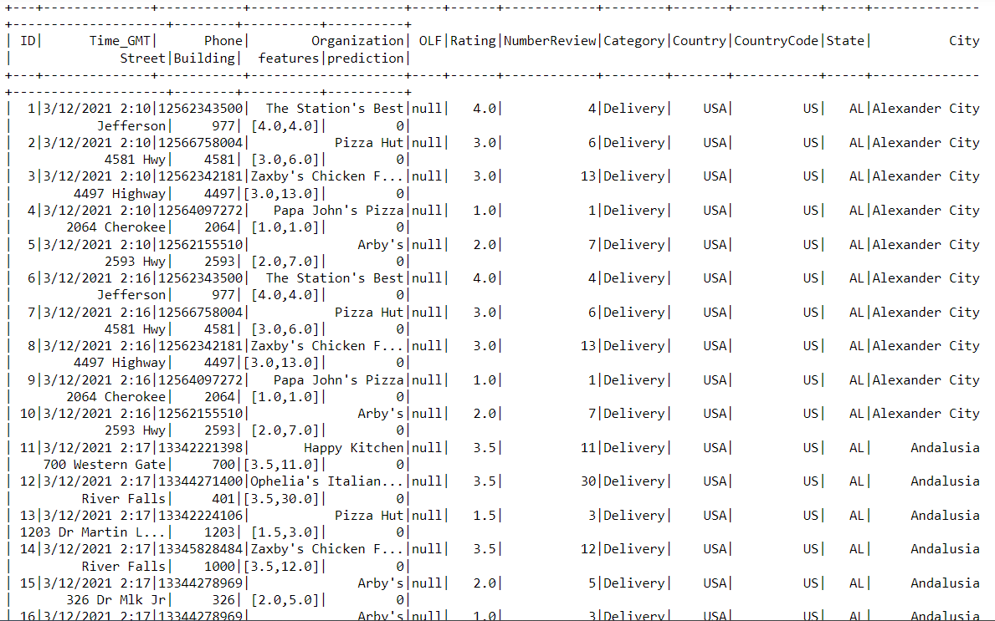
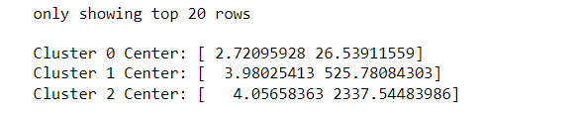
Clustering Analysis
The cluster_centers variable will store the coordinates of each cluster center. These coordinates indicate the average values of the selected features within each cluster.
Cluster 0 Center: [Rating: 2.72, Number of Reviews: 26.49]
Cluster 1 Center: [Rating: 4.06, Number of Reviews: 2314.81]
Cluster 2 Center: [Rating: 3.98, Number of Reviews: 523.50]

Slide 17
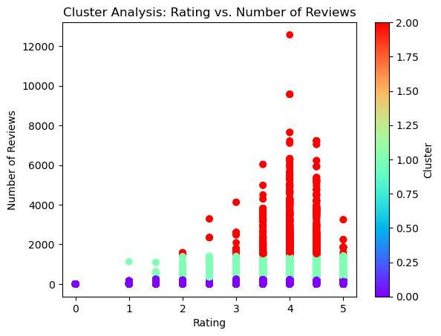
Rating vs. Number of Reviews

Slide 18
Conclusion
1. Data Analysis and Insights:
The analysis revealed the top-rated organizations, allowing for recognition of businesses that consistently received positive reviews. Understanding the distribution of ratings and reviews provided insights into customer sentiments and satisfaction levels. Exploring the most common categories helped identify popular business types and industry trends.
The conclusions from the cluster analysis provide Yelp with actionable insights to enhance recommendations, targeted marketing, and market understanding for improved user experience and support for restaurant owners.
2. Limitations and Future Considerations:
The analysis focused on a specific dataset, and the findings are specific to the Yelp dataset used. Generalization to other datasets should be done cautiously. Further analysis could include sentiment analysis of reviews using natural language processing techniques to extract more detailed insights. Incorporating external data sources, such as demographic data or social media trends, could enrich the analysis and provide a broader context.

Slide 19
Thank you

